Slide 1
Networking (recap)
September 20, 2018

Slide 2
TCP/IP Networking Basics

Slide 3
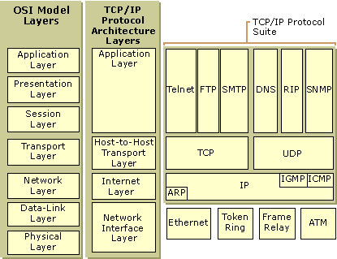
TCP/IP protocol stack

Slide 4
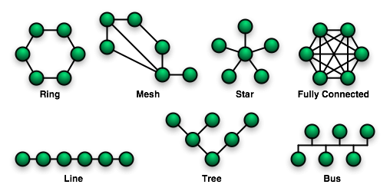
Network Topology Types

Slide 5
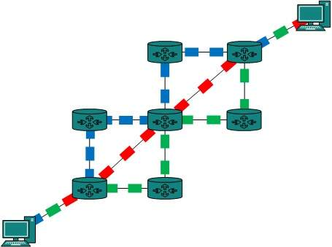
Packet Switching

Slide 6
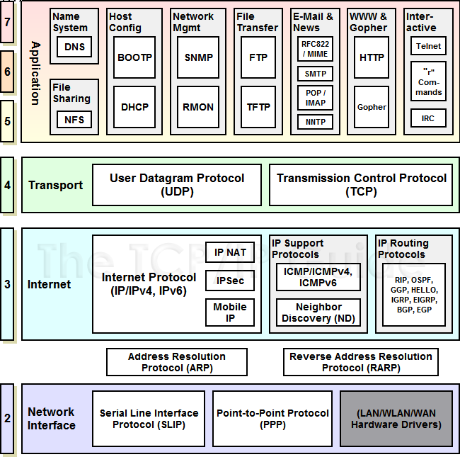
TCP/IP Protocols - Routing

Slide 7
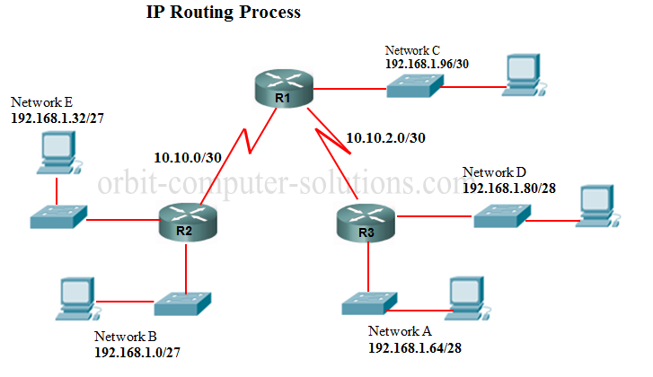
IP Routing

Slide 8
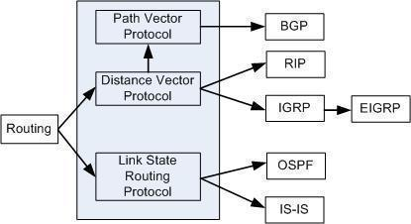
Routing Protocols
Metrics
Hop count
Bandwidth
Delay
Load
MTU
Cost

Slide 9
TCP/IP Networking Tools

Slide 10
Demonstration of socat
Set up a tcp server:
socat tcp-listen:8080,reuseaddr,fork exec:'bc -l'
Connect to it:
echo '4 * a(1)' | socat - tcp:localhost:8080

Slide 11
Basic networking tasks
Scan localhost with nmap
Start an echo server on port 8080 with the following command:
socat udp-listen:8080,fork,reuseaddr exec:cat
Try scanning localhost again
Send some text to it:
echo Hello world | socat - udp:localhost:8080
man ls | socat - udp:localhost:8080

Slide 12
Basic networking tasks
Repeat the previous tasks while running: tcpdump -i lo -s0 -XX
See what nethogs shows while you use the network

